Slide 1
Rockbuster Stealth
Holly Ringsak

Slide 2

Key Questions and Objectives
Which movies contributed the most/least to revenue gain?
What was the average rental duration for all videos?
Which countries are Rockbuster customers based in?
Do sales figures vary between geographic regions?
Where are customers with a high lifetime value based?
Which genres contributed the most/least to revenue gain?

Slide 3
Data Overview
Catalogue Size | 1001
Customer Count | 599
Country Count | 109
 | Rental Duration (days) | Rental Rate (USD) | Replacement Cost (USD)
Minimum | 3 | 0.99 | 9.99
Maximum | 7 | 4.99 | 29.99
Average | 4.98 | 2.98 | 19.98

Slide 4
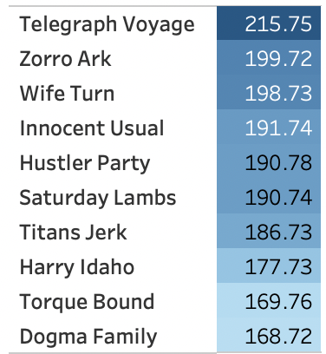
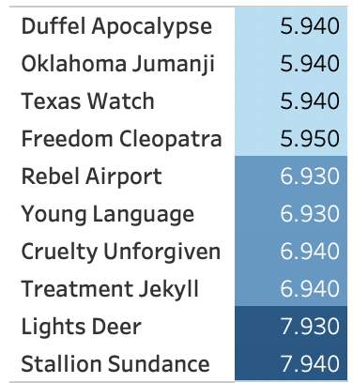
Which movies contributed to the least/most revenue gain?
Top 10 Movies
Bottom 10 Movies
USD
USD

Slide 5
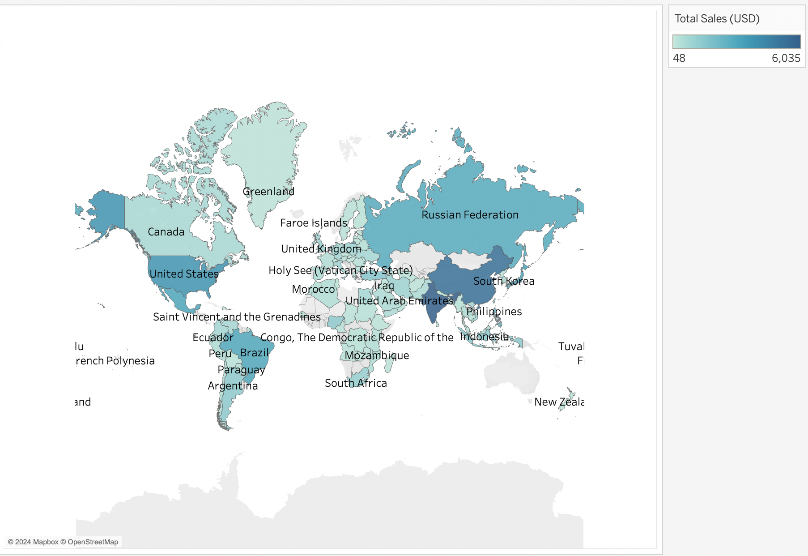
Which countries are Rockbuster customers based in?
The top 5 countries with the highest total sales:
India
China
United States
Japan
Mexico

Slide 6
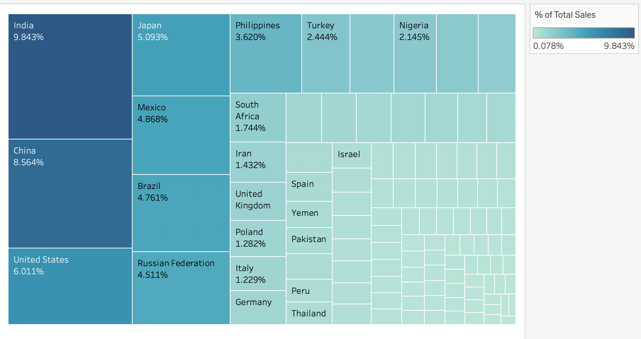
Do sales figures vary between geographic regions?
The top 5 countries with the highest total sales make up 34.379% of the entire market.
The top 5 countries are India, China, United States, Japan, and Mexico.
Brazil and Russian Federation are also important to note as they are very close in sales to Mexico.

Slide 7
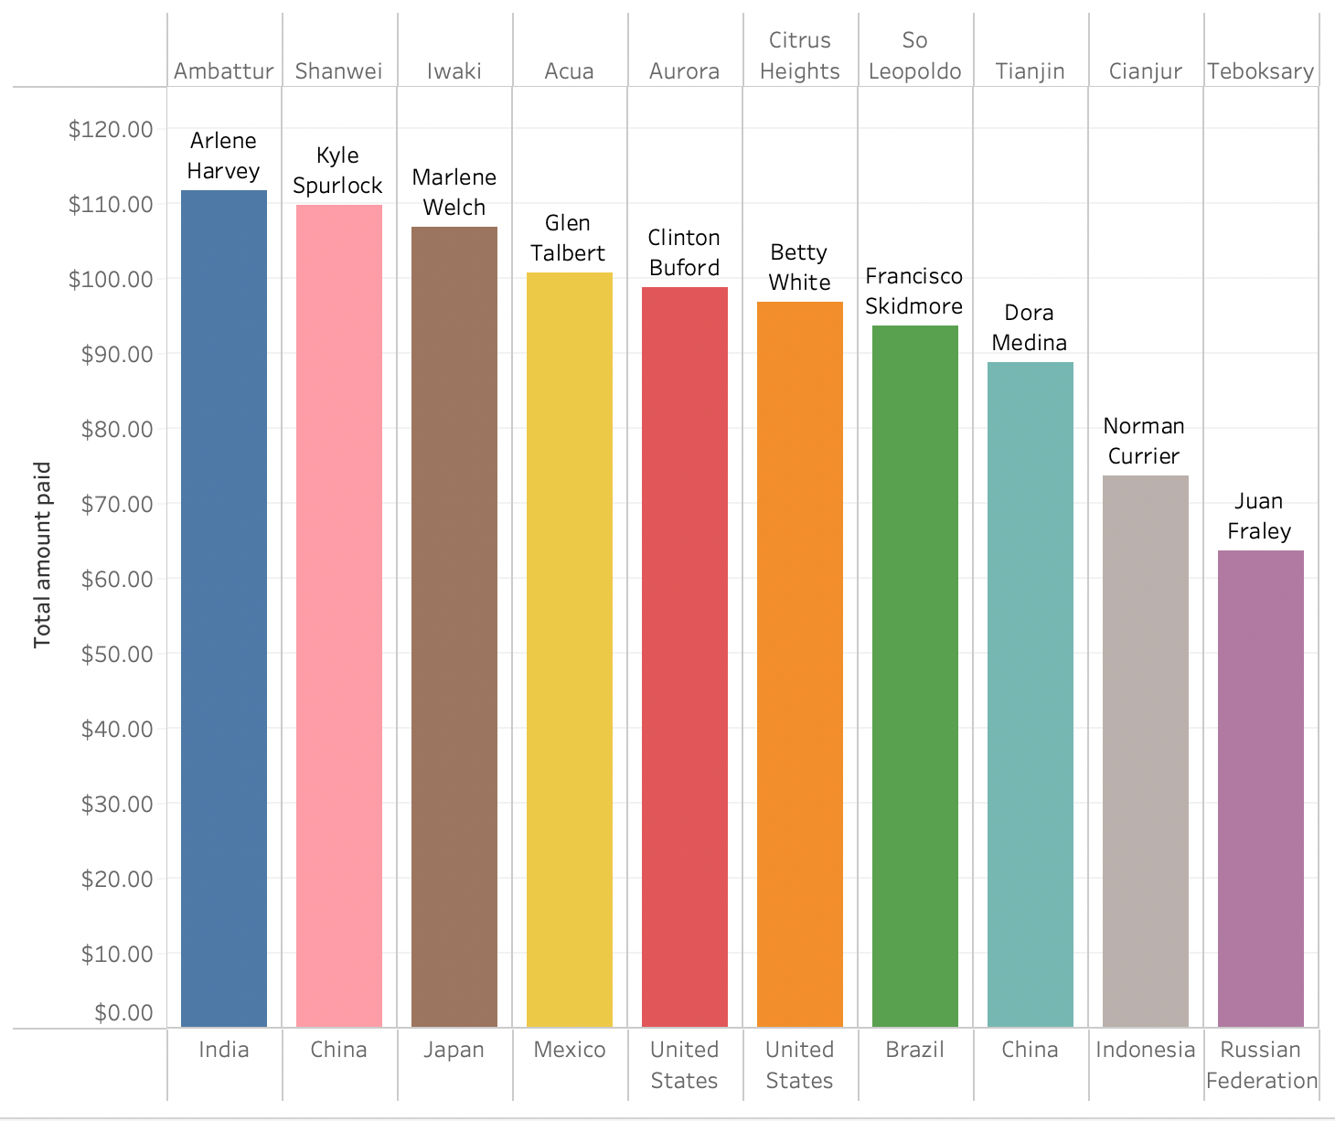
Top 10 customers with a high lifetime value
The top 5 customers are all within our top 5 countries with the highest number of sales.

Slide 8
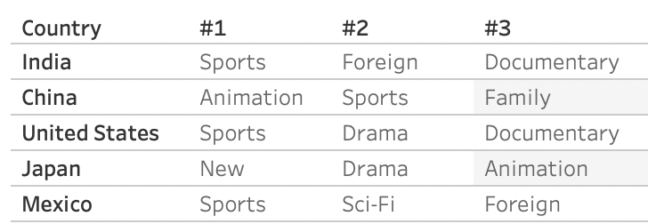
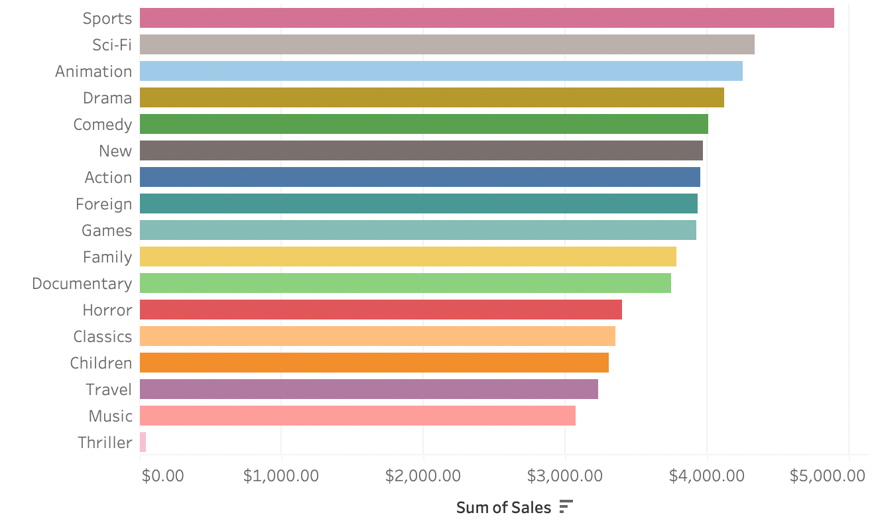
Which genres created the most revenue?
Our top 5 highest performing genres are Sports, Sci-Fi, Animation, Drama, and Comedy.
Sports is the highest ranking genre in India, the United States, and Mexico.

Slide 9
Conclusion
Top movies contributing to revenue gain are Telegraph Voyage, Zorro Ark, Wife Turn, Innocent Usual, and Hustler Party.
Countries with the highest sales numbers are India, China, United States, Japan, and Mexico.
Our top 5 countries with highest sales numbers make up 34.379% of the market.
The top genres are Sports, Sci-Fi, Animation, Drama, and Comedy.
The majority of our high lifetime value customers are from our highest performing countries.

Slide 10
Recommendations
Develop a rewards program to encourage more customer loyalty and increase the number of customers with a high lifetime value
Advertise the availability of most popular movies
Advertise movies of a specific genre in regions where they are the most popular. Focus Sports advertising in India, China, United States, and Mexico. Animation in China and Japan.
Allocate the marketing budget for the upcoming year based on the percentage of total sales by region.
India – 9.843 %
China – 8.564%
United States – 6.011%
Japan – 5.093%
Mexico – 4.868%

Slide 11
Further Analysis
Look into what languages have the highest total sales and potentially add more movies in those languages to the catalogue
Compare popularity and availability of each genre and expand catalogue for popular genres with less titles available.

